Slide 1


Seismic Piezocone Testing: The
Versatile Means for Geotechnical Site Exploration in 2020 and Beyond
21st Robert L. Schiffman '44 Geotechnical Colloquium
Cornell University - Civil & Environmental Engineering
Paul W. Mayne, PhD, P.E., BS'74, ME'77, PhD'91
Georgia Institute of Technology
Tuesday 05 November 2019
366 Hollister Hall

Slide 2
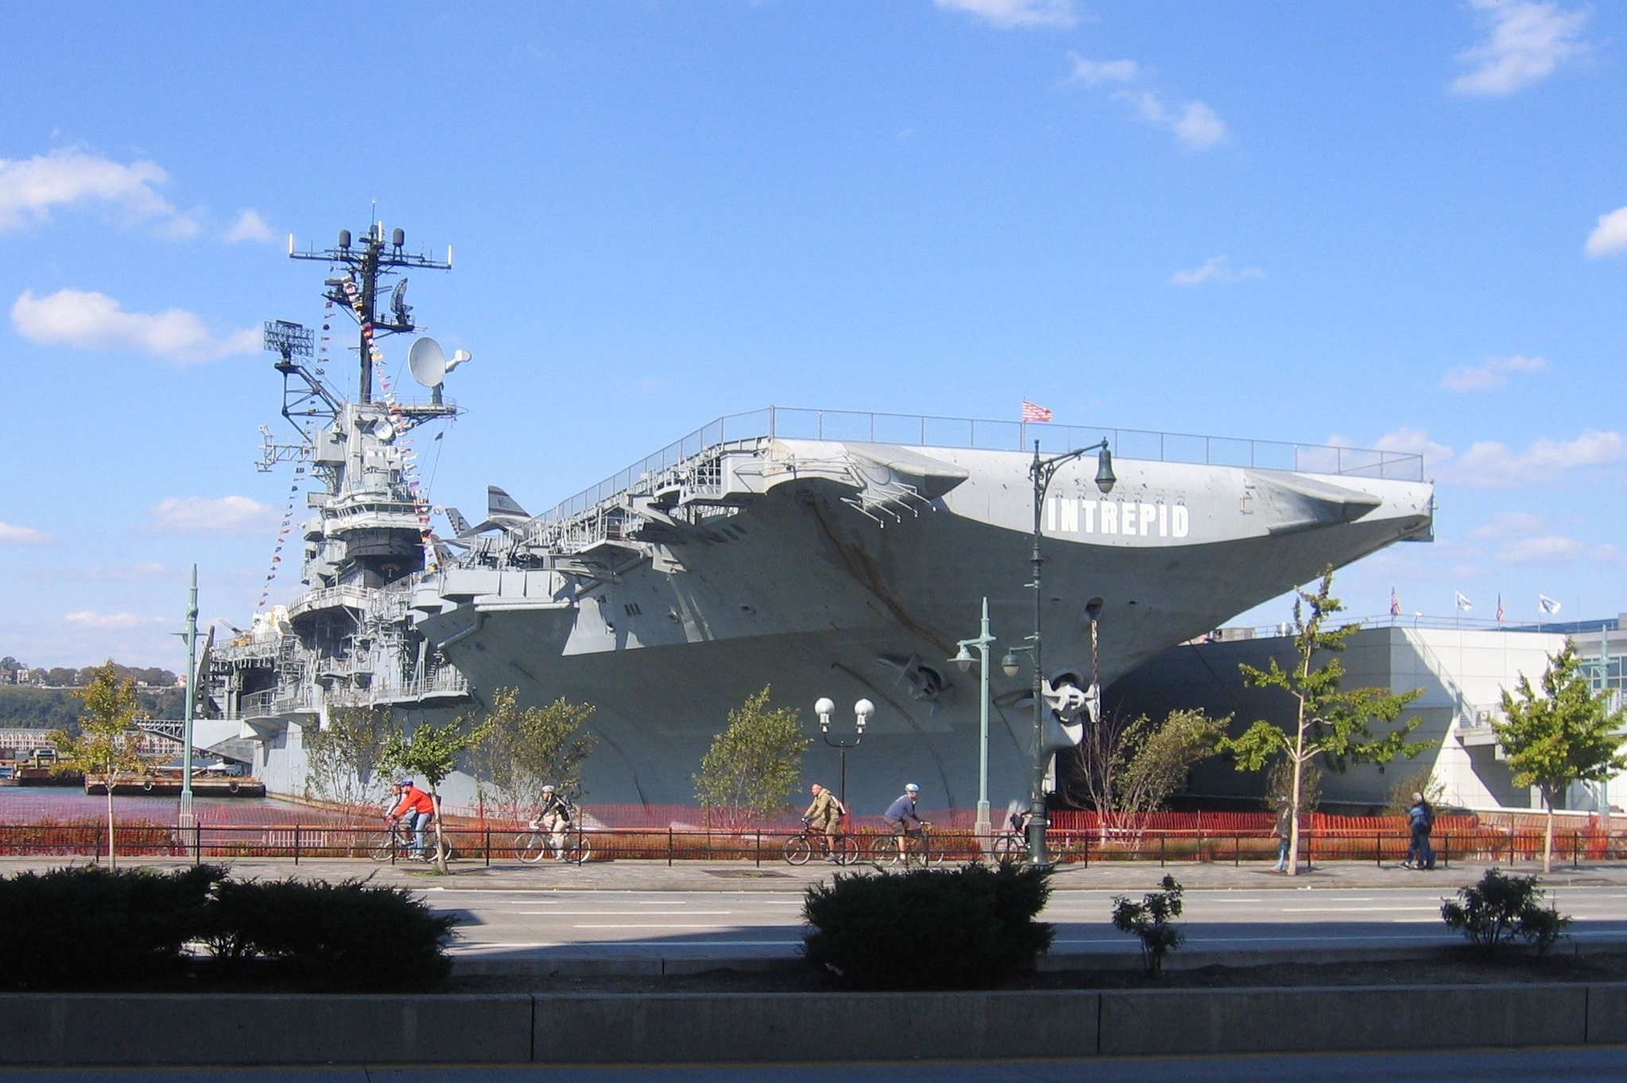
USS Intrepid

Slide 3

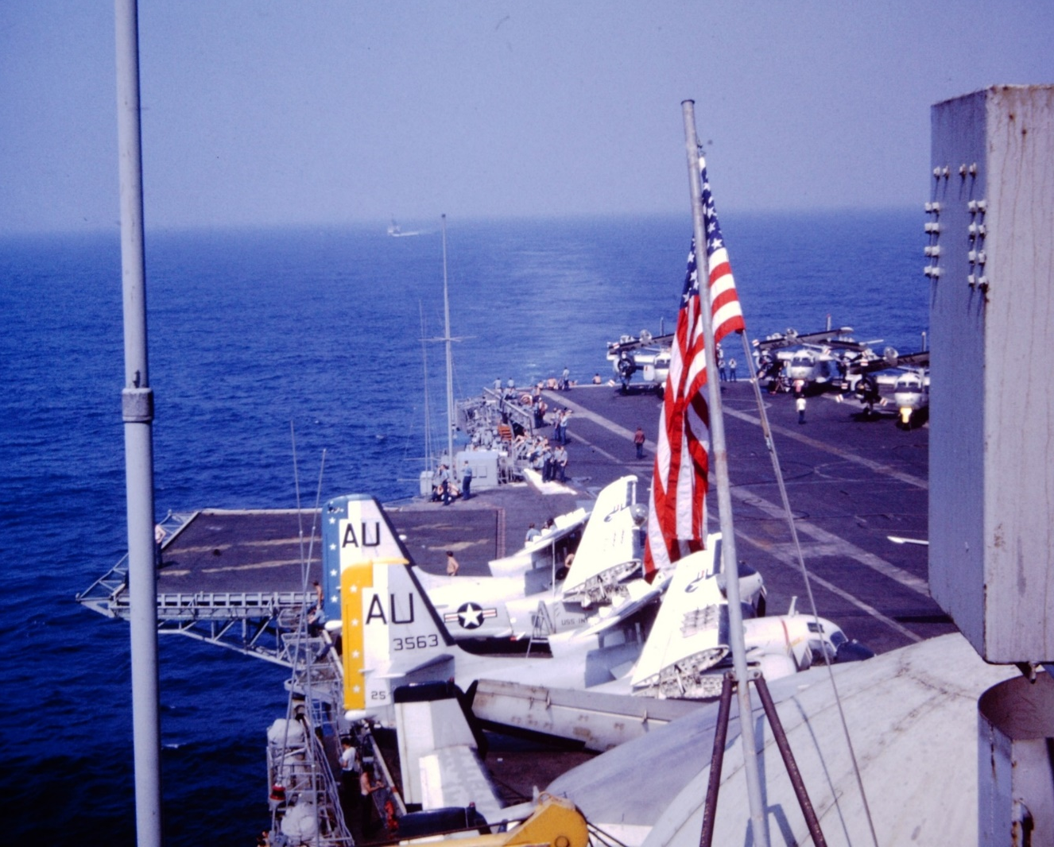
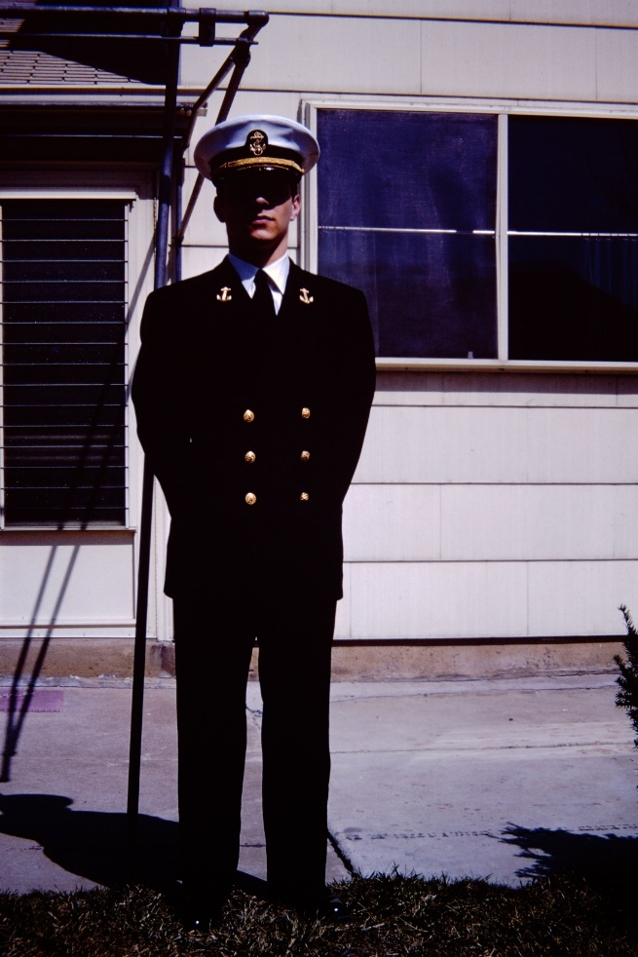
USS Intrepid in 1971

Slide 4
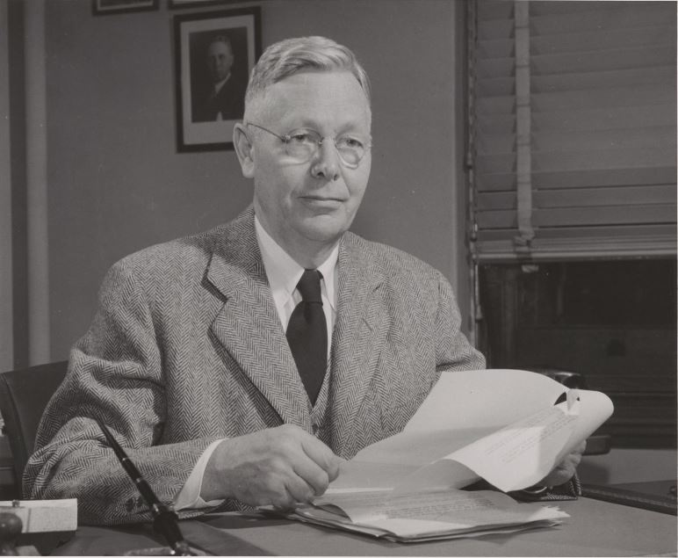
Solomon Cady Hollister (1891-1982)

Slide 5
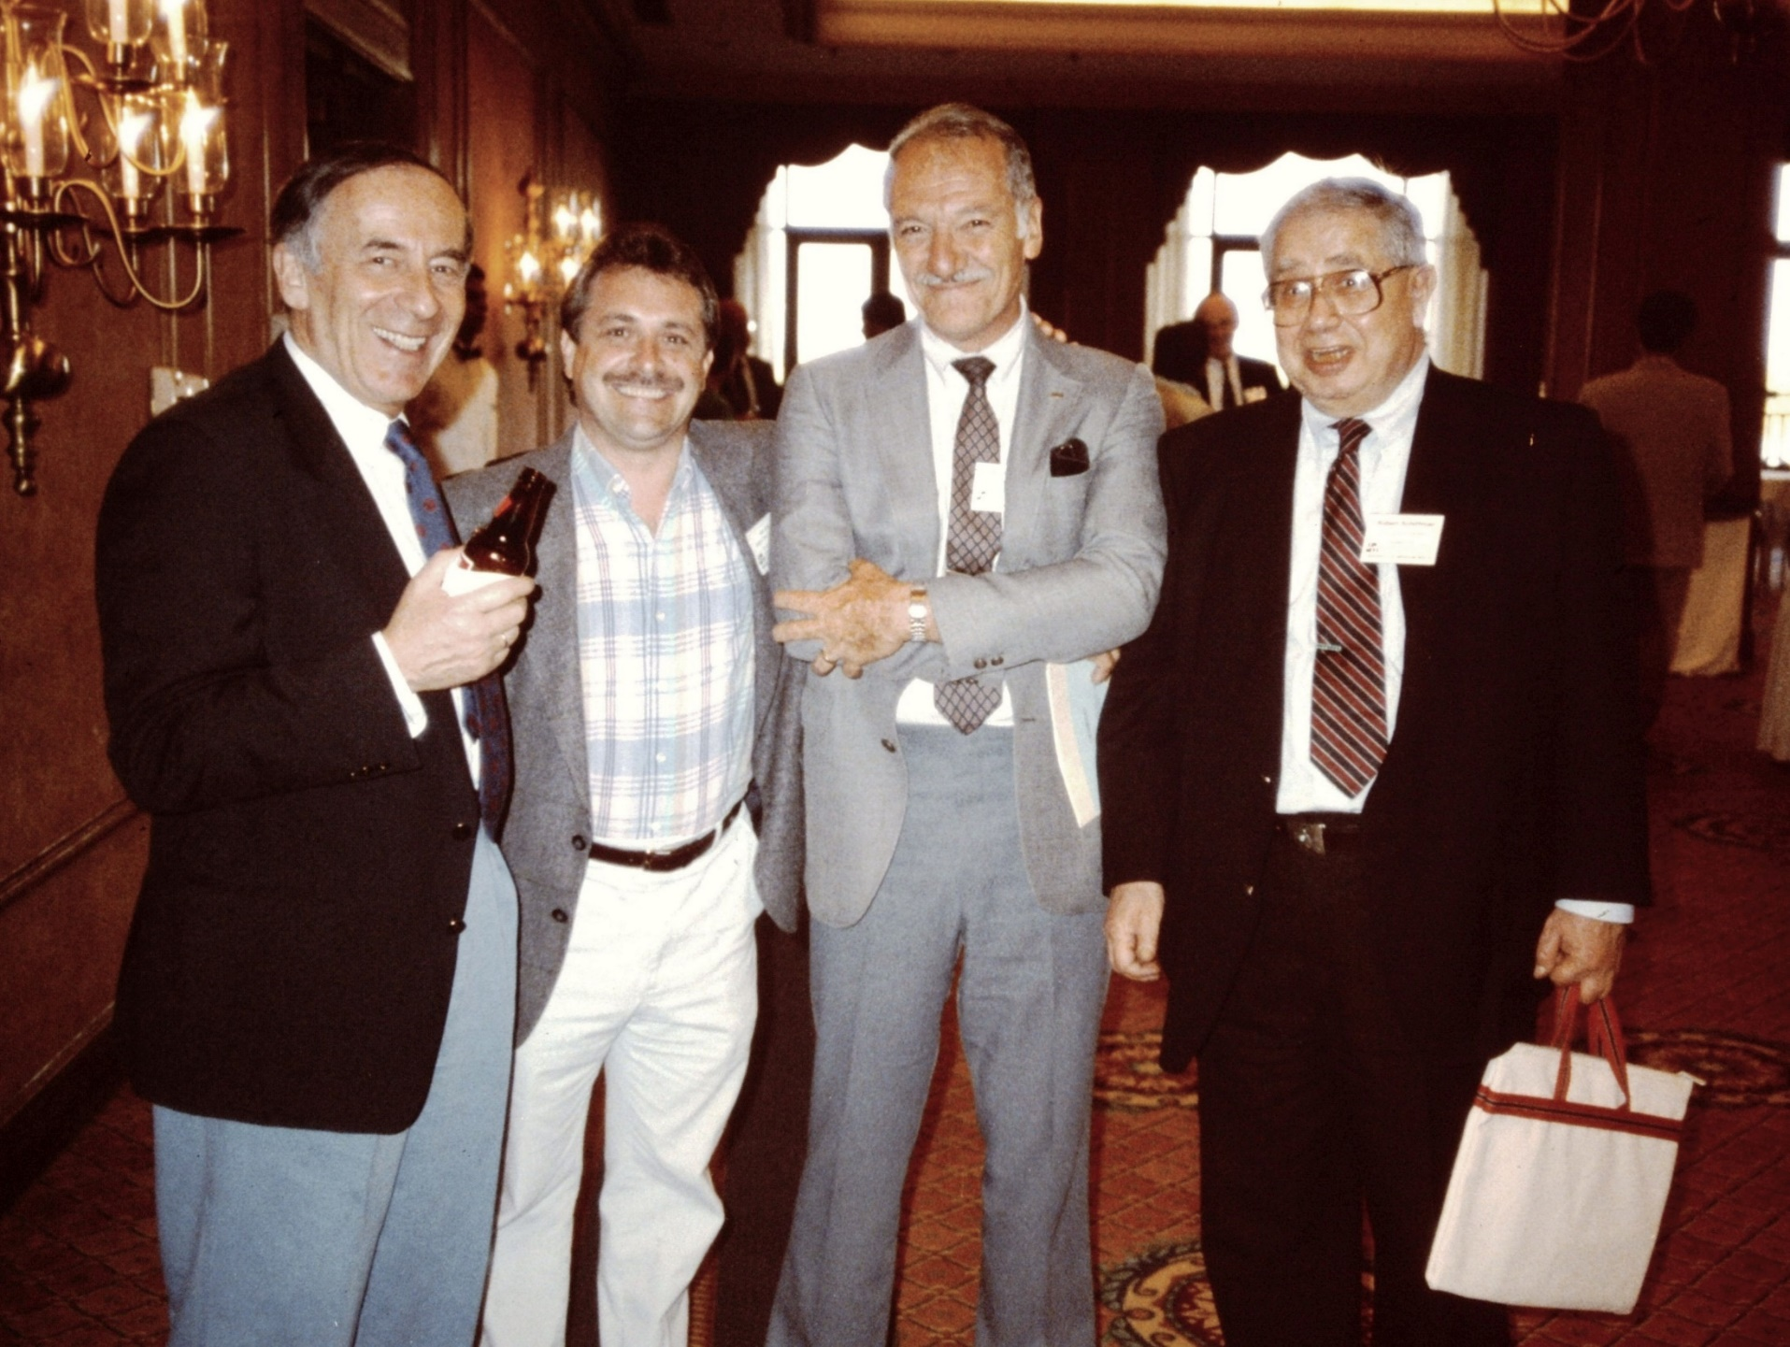
Prof. Mike
Jamiolkowski
Prof. Paul
Mayne
Prof. Mehmet
Tumay
Prof. Bob
Schiffman

Slide 6
Purposes: Geotechnical Site Investigation
A must prior to all geotechnical projects
Determine geostratigraphy for site development
Obtain information for construction and foundation selection or ground modification
Collect geotechnical data for parameter evaluation
Input to analytical models and numerical FEM
Minimize surprises during construction
Mitigate potential for legal involvement

Slide 7
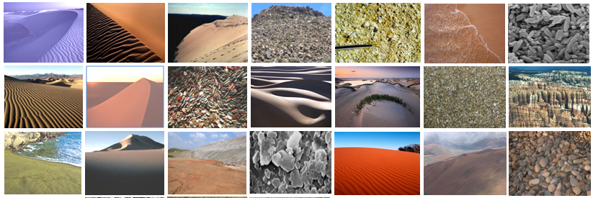
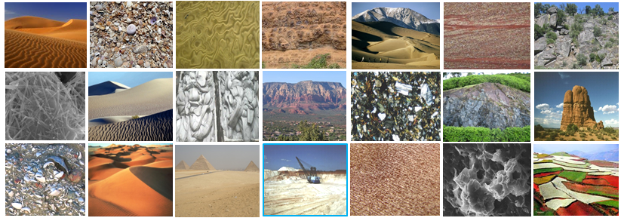
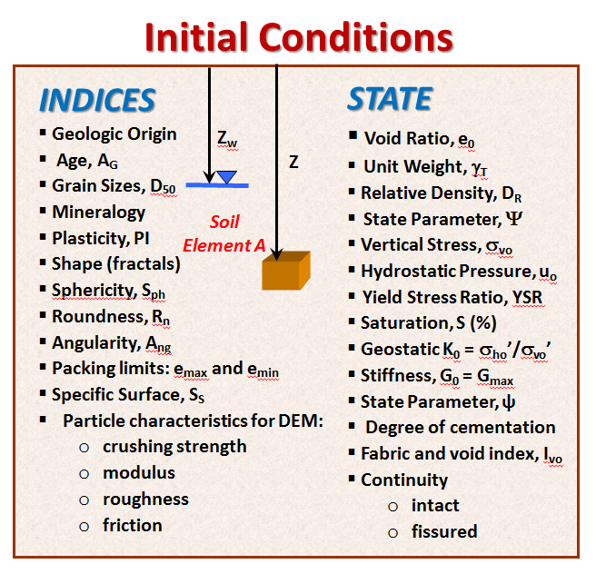
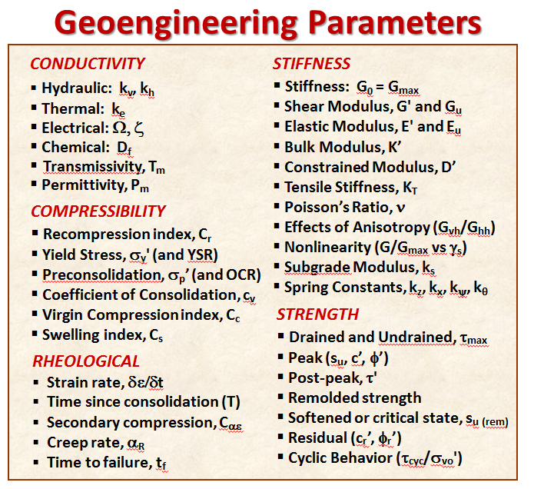
Geomaterial Characteristics

Slide 8
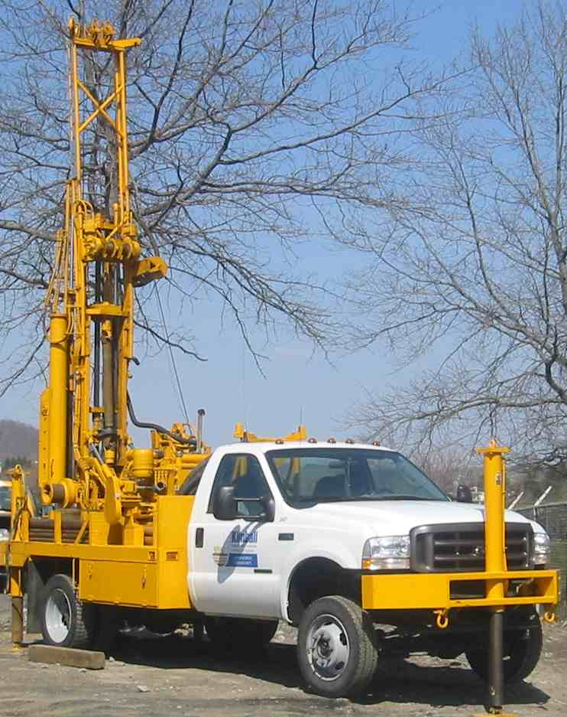
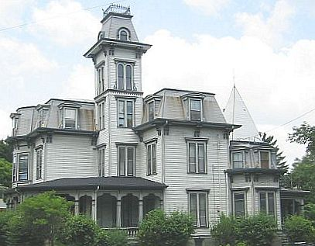


BEST APPROACH
SOILS LABORATORY
UD
tube
CONVENTIONAL DRILLING
& SAMPLING
IN-SITU
Seismograph
CPT
DMT
Pump tests
TX CS RC PM
GEOPHYSICS
Dynamic Penetration
SPT:
N₆₀
φ'
D_{R}
DSS
Crosshole
CHT
V_{s}, V_{p}
G_{max}
TX = triaxial shear
CS = consolidation
DSS = direct simple shear
RC = resonant column
PM = permeameter
DENSE
SAND
FIRM
CLAY
Pressuremeter (PMT)
P₀ = lateral stress
G’ = shear modulus
s_{uPMT} = shear strength
P_{L} = limit pressure
Vane Shear (VST):
s_{uv} = shear strength
S_{t} = sensitivity
TEXAM

Slide 9

Mechanical Laboratory Testing Methods
Hyd
Cup
PSC PSE
HC RCT
Sieves
UC
TTx
Oed
Fall
Cone
Consolidometers
DSB
BE
DSS
Tv
CIUC
CIDC
CKoUC
CKoDC
CKoUE
CKoDE
CIUE
CIDE
w_{n}
Pp
Iso
Consol
Permeameters
RS
DSC
Vst
Pan
Grain size analyses
Hydrometer
Water content by oven
Liquid limit cup
Plastic limit thread
Fall cone device
Pocket penetrometer
Torvane
Unconfined compression
Miniature vane
Digital image analysis
Mechanical oedometer
Consolidometer
Constant rate of shear (CRS)
Falling-head permeameter
Constant-head permeameter
Flow permeameter
Direct shear box
Ring shear
Unconsolidated undrained Tx
Simple shear
Directional shear cell
Triaxial apparatus (iso-consols, CIUC, CKoUC, CAUC, CIUE, CAUE, CKoUE, stress path, CIDC, CKoDC, CIDE, CKoDE, constant P’)
Plane strain apparatus (PSC, PSE)
True triaxial (cuboidal)
Hollow cylinder
Torsional Shear
Resonant Column Test device
Non-resonant column
Bender elements

Slide 10
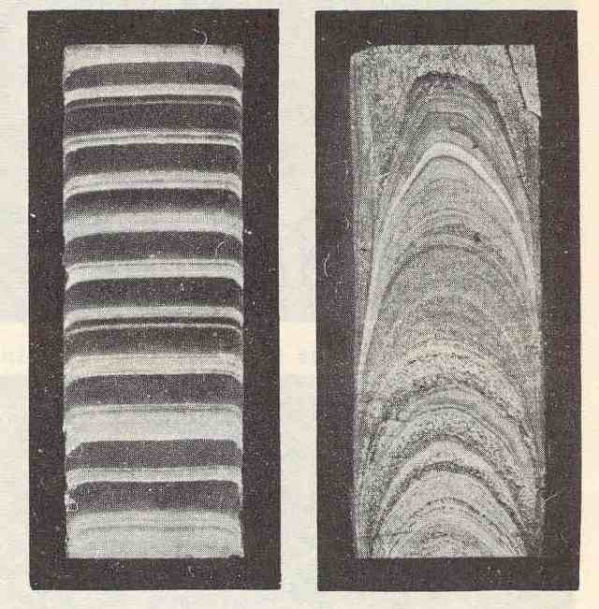
Laboratory Soils Testing
Varved Clay
  Limited number (discrete points)
  Lengthy test durations
  Affected by sample disturbance
  Expensive: Cost per specimen:
    Oedometer = $600 (2 weeks)
    Automated Consolidation = $800 (2-3 days)
    CIUC Triaxial = $600 (2 to 3 days)
    CK₀UC Triaxial = $1500 ea (5 days)
    Resonant Column= $2000 ea (1 week)
    Permeability = $800 (1 to 2 weeks)
Sampler A Sampler B

Slide 11

Geotechnical Methods for Site Investigation
Soils Laboratory
Lab Rat

Slide 12
Field Geotechnical In-Situ Testing Methods
SPT
SPLT
PMT
TSC
Full Flow Penetrometers
SPTT
TxPT
SWS
MPT
RapSochs
LPT
CPMT
PV
RCPTu
BPT
DMTà
VST
PPT
PBPT
SCPMTù
DMT
K₀SB
HF
CPT
TBPT
CPTù
SCPTu
PLT
FTS
HPT
DEPPT
BST
CPTu
SDMT
SPT = Standard Penetration Test
TxPT = Texas Penetration Test
VST = Vane Shear Test
PMT = Pressuremeter Test
CPMT = Cone Pressuremeter
DMT = Dilatometer Test
SPLT = Screw Plate Load Test
ISB = Iowa K₀ Stepped Blade
SWS = Swedish Weight Sounding
HF = Hydraulic Fracture
BST = Borehole Shear Test
TSC = Total Stress Cell (spade cell)
FTS = Freestand Torsional Shear
PV = Piezovane
MPT = Macintosh Probe Test
CPT = Cone Penetration Test
CPTu = Piezocone Penetration
RCPTu = Resistivity Piezocone
SCPTu = Seismic Cone
SDMT = Seismic Flat Dilatometer
TBPT = T-Bar Penetrometer Test
BPT = Ball Penetrometer
PPT = Plate Penetration Test
PLT = plate load test
HPT = Helical Probe Test
PBPT = piezoball penetration test
RapSochs = Rapid soil characterization system
CPTù = piezodissipation test
DMTà = Dilatometer test with A-reading dissipations
SPTT = Standard Penetration Test with Torque
LPT = Large Penetration Test
DEPPT = Dual Element PiezoProbe Test
SCPMTu = Seismic Piezocone Pressuremeter

Slide 13
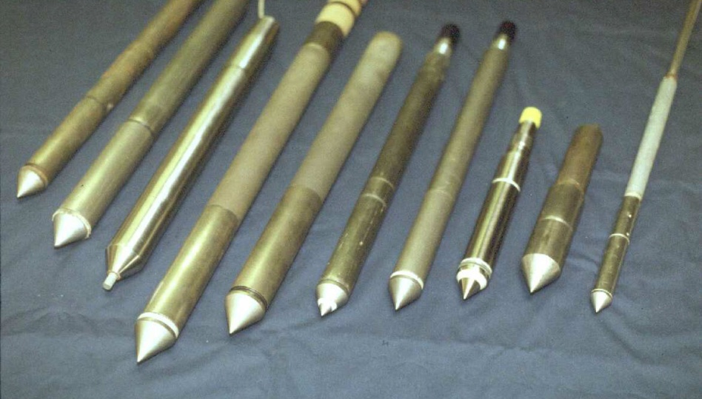
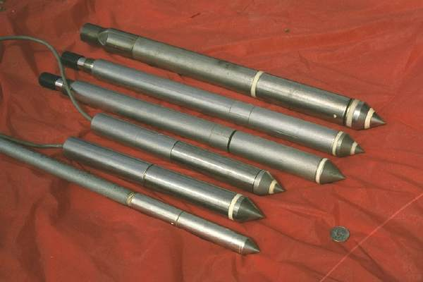
Cone Penetrometer Test (CPT)
Electronic Steel Probes with 60° Apex Tip
ASTM D 5778 Procedures
Hydraulic Push at 20 mm/s
No Boring, No Samples, No Cuttings, No Spoil
Continuous readings of stress, friction, pressure
Immediate access to digital data

Slide 14
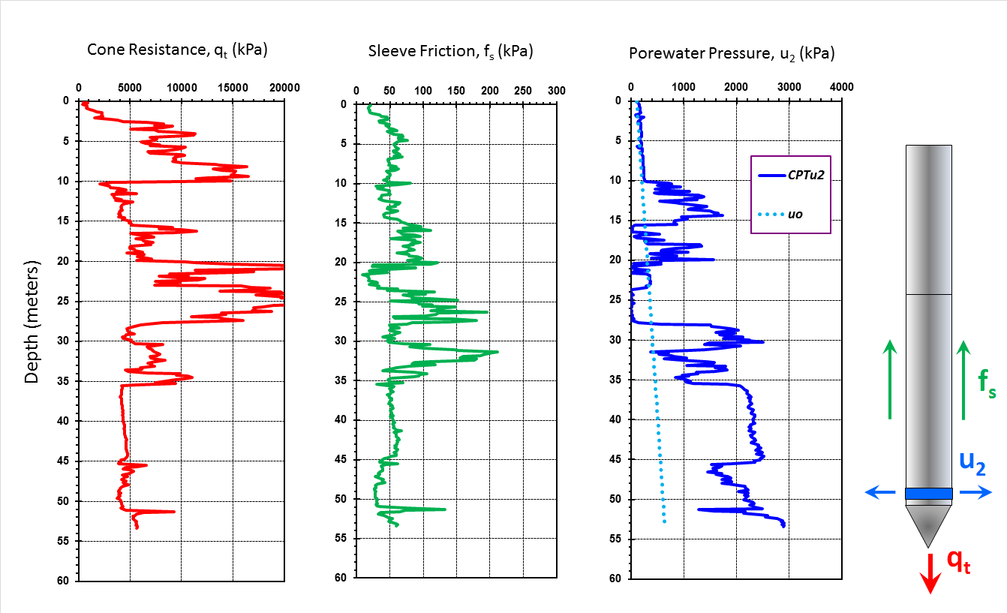
Geostratigraphy by CPTu in Portsmouth, Virginia

Slide 15
CPT
Current Phase Tranformer
Cross Product Team
Cellular Paging Teleservice
Chest Percussion Therapy
Crisis Planning Team
Consumer Protection Trends
Computer Placement Test
Current Procedural Terminology
Cost Per Treatment
Choroid Plexus Tumor
Cardiopulmonary Physical Therapy
Corrugated Plastic Tubing
Cumulative Price Threshold
Cell Prepartion Tube
Central Payment Tool
Certified Proctology Technologist
Cockpit Procedures Trainer
Color Picture Tube
Critical Pitting Temperature
Certified Phelbotomy Technician
Control Power Transformer
Cone Penetration Test
Cost Production Team
Channel Product Table
Conditional Probability Table
Command Post Terminal

Slide 16
Repeatability of CPTs
Chalmette Levees, New Orleans
Location LPV 146-53c

Slide 17
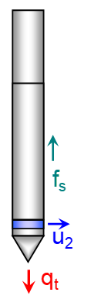
CPTu from Blytheville, Missouri
5 MPa (50 tsf)
CLAY
SAND

Slide 18
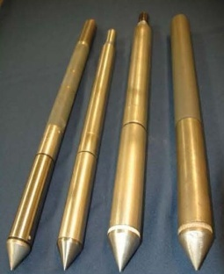
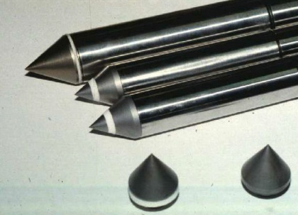
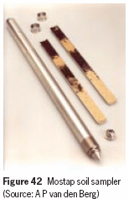
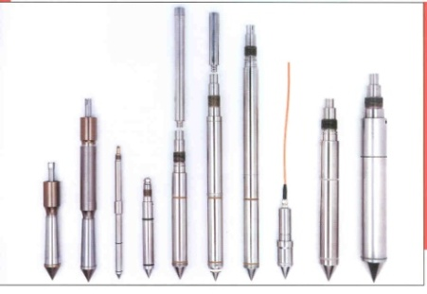


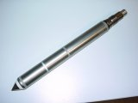
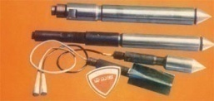
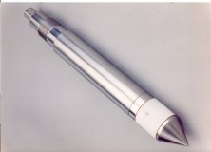
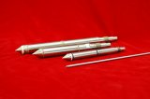
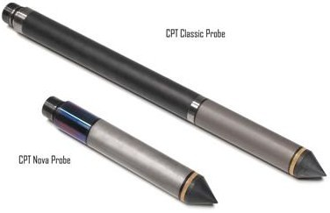
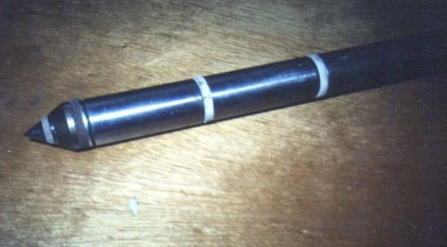
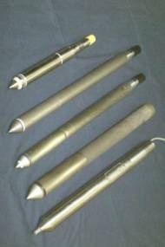
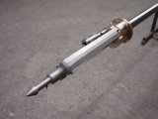
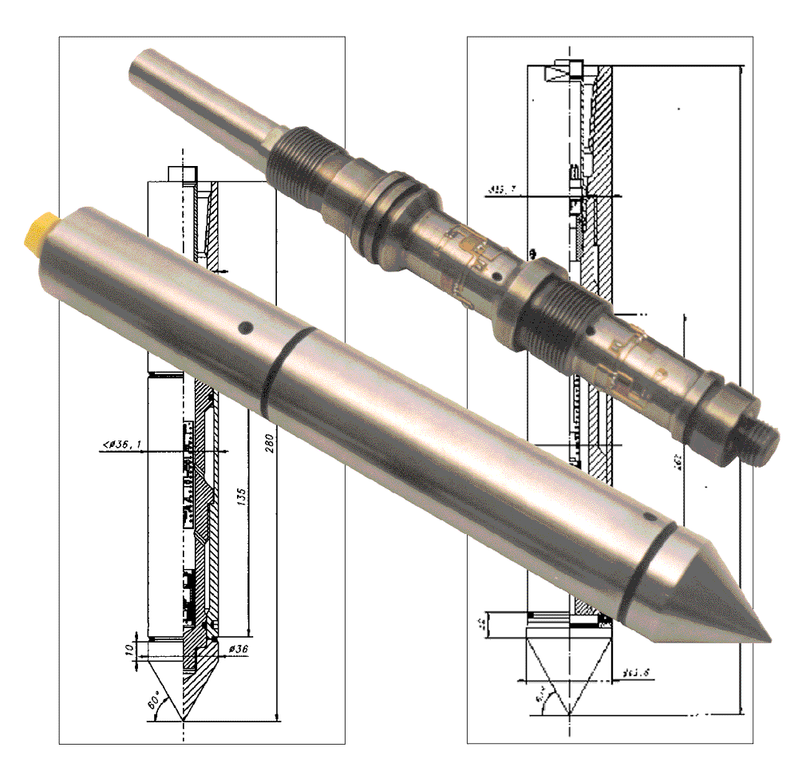
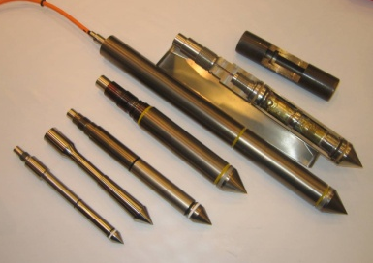
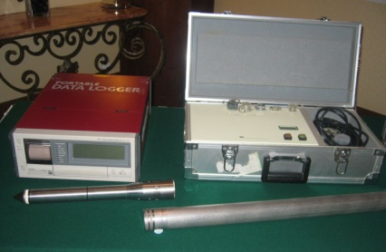
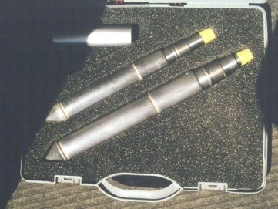
Cone Penetrometers
10-cm²
15-cm²
mechanical
electric
cabled
piezo-
electronic
seismic-
digital
wireless

Slide 19
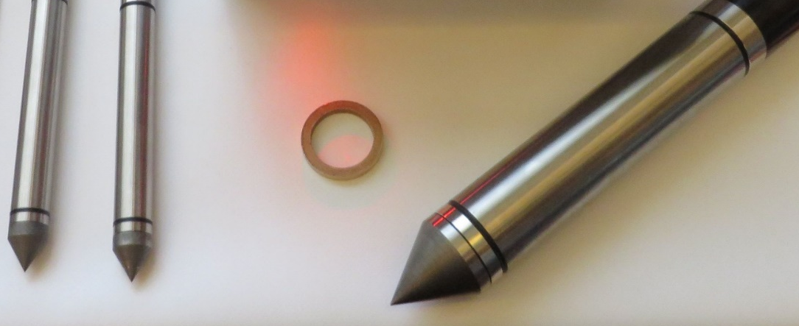
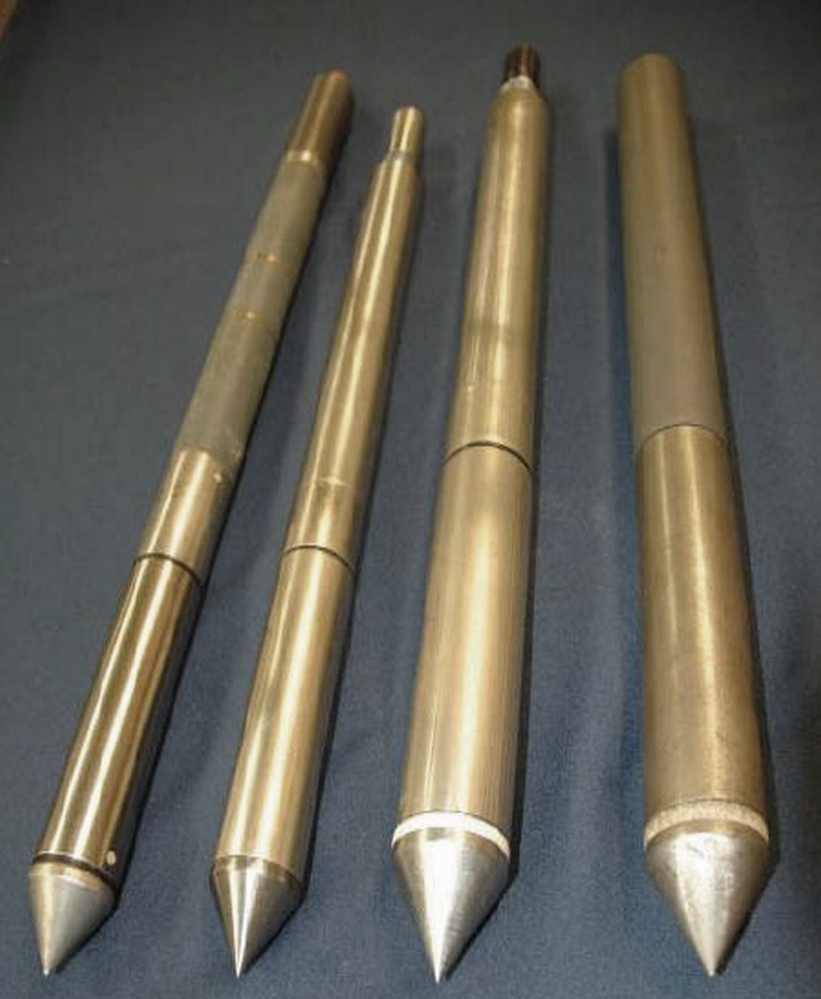
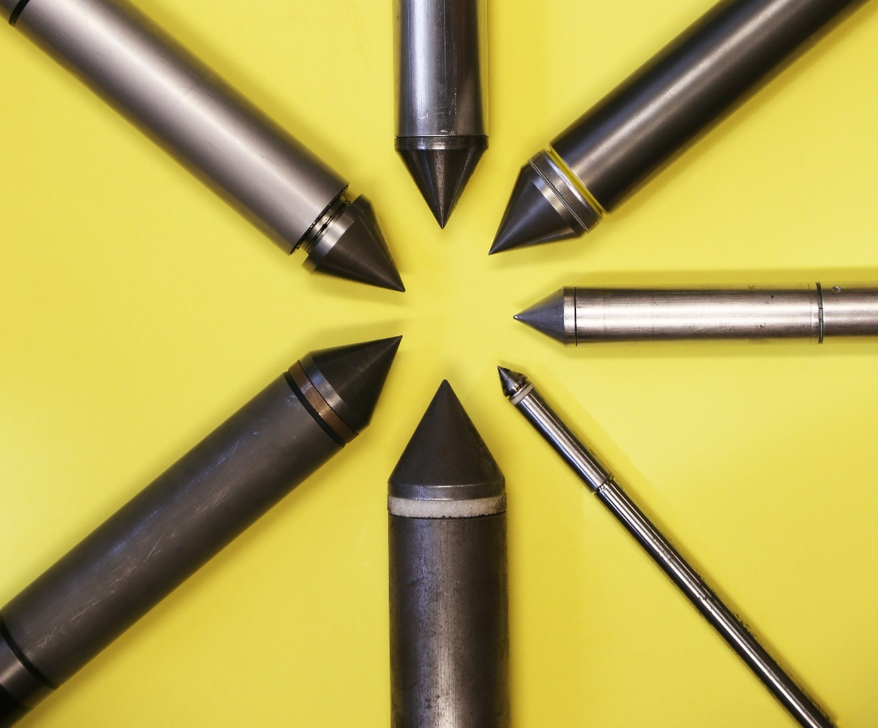
Cone Penetrometer Sizes
d = 35 mm d = 44 mm
2 cm² 10 cm²
10 cm² 10 cm² 15 cm² 15 cm²
10 cm²
5 cm²
1 cm²
15 cm²

Slide 20
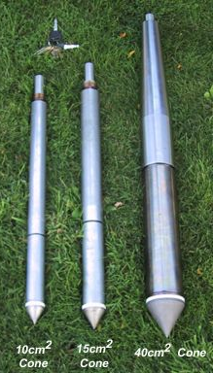
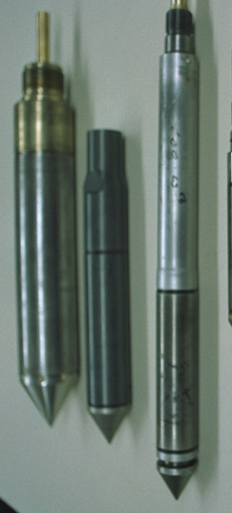
Cone Penetrometer Sizes
33 cm²
15 cm²
10 cm²
Fugro
Penetrometers
ConeTec
Group

Slide 21

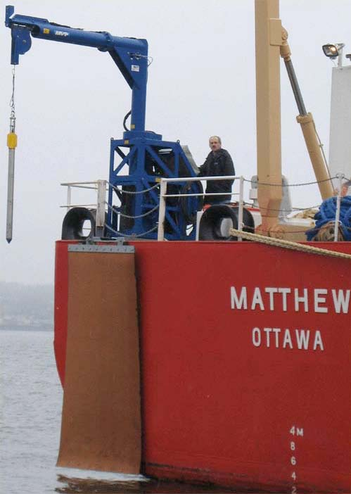
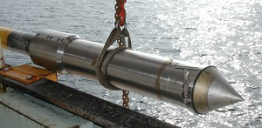
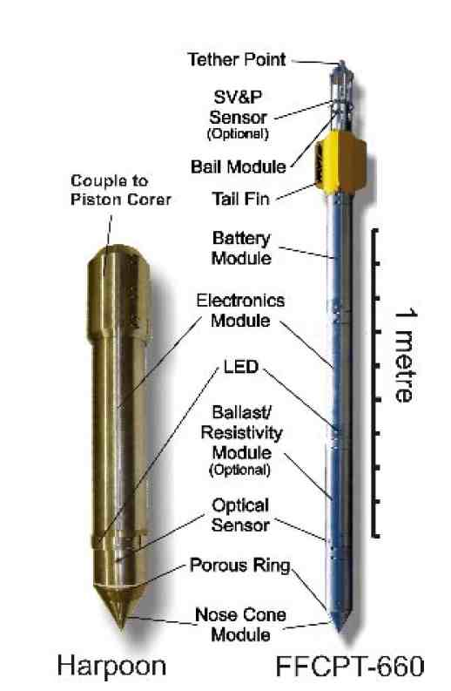
CPT'10 - Summary Regional Reports
Harpoon Type Cone Penetrometers
"Free-Fall Cone Penetration Test"
US Navy XDP
Canadian FFCPT
German MARUM
Australian FFP
44 mm < d < 168 mm

Slide 22
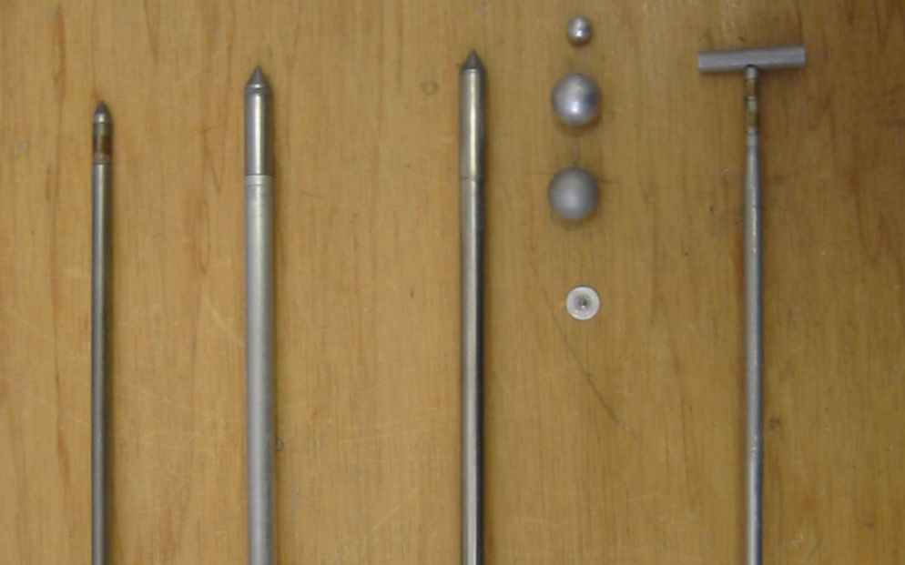
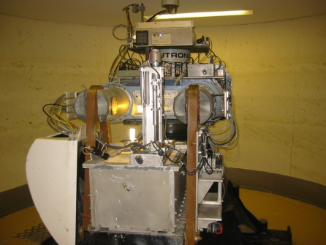
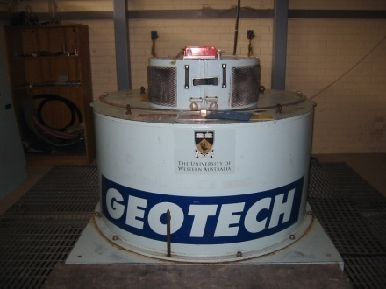
CPT'10 - Summary Regional Reports
CPT Probes for Centrifuge - Univ. Western Australia
0 50 mm
Mini-Cone Penetrometers
T-bar
Ball
Main Centrifuge
Plate
Drum Centrifuge

Slide 23
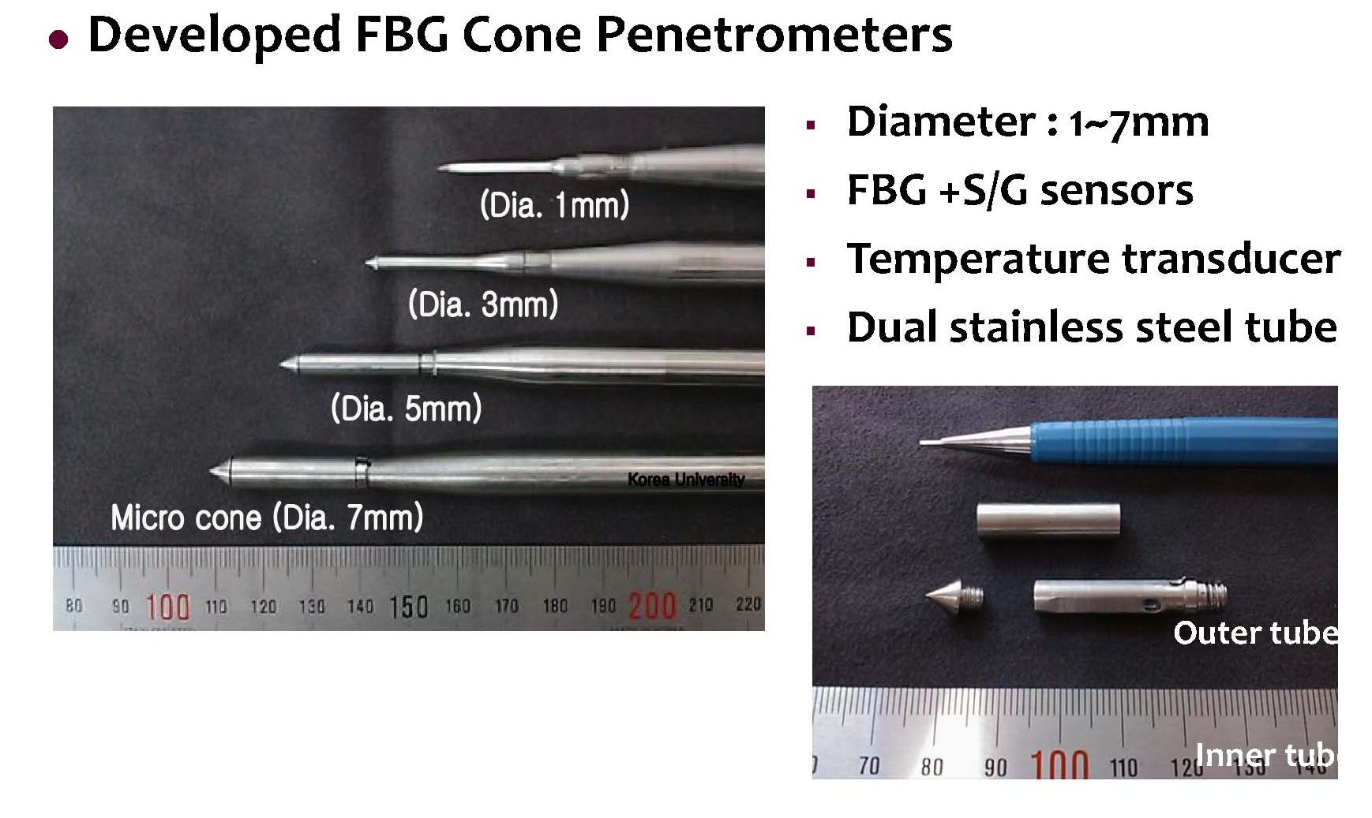
Micro-Cone Penetrometers
Kim, Choi, Lee & Lee: Korea University
(GeoFlorida 2010)
FBG = Fibre Bragg Grating sensor

Slide 24
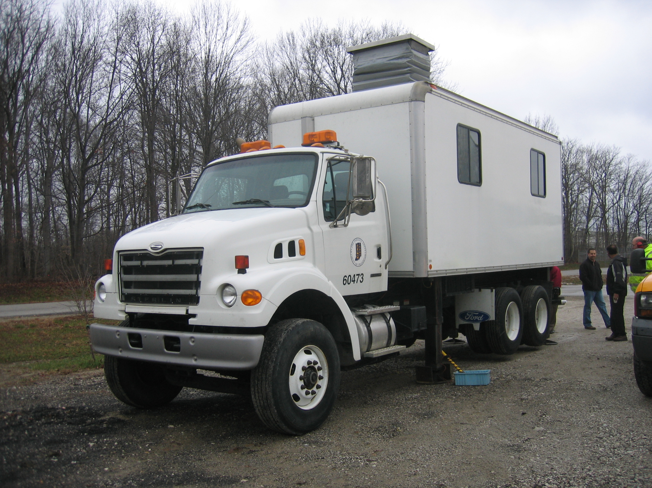
Cone Penetration Vehicles
InDOT

Slide 25
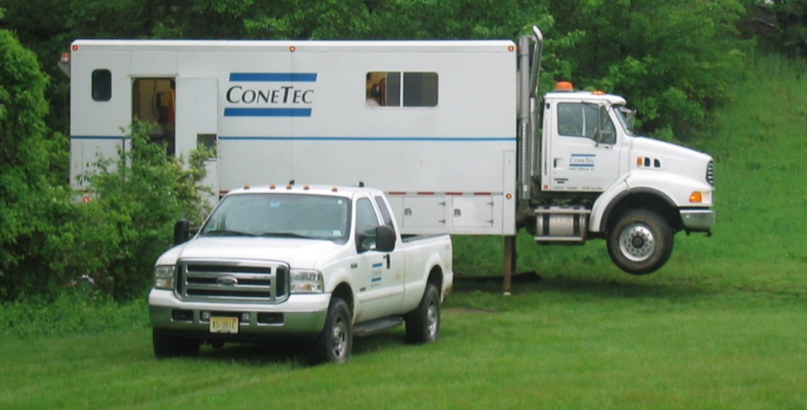
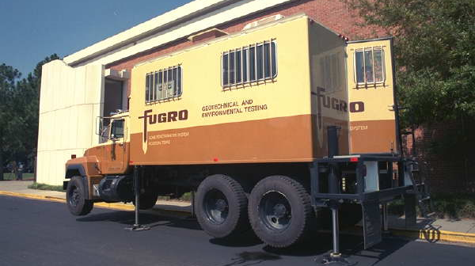
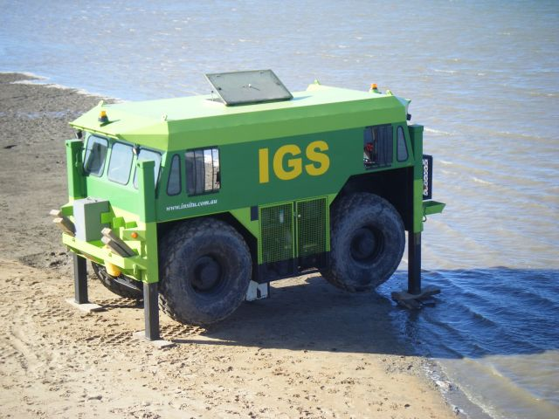
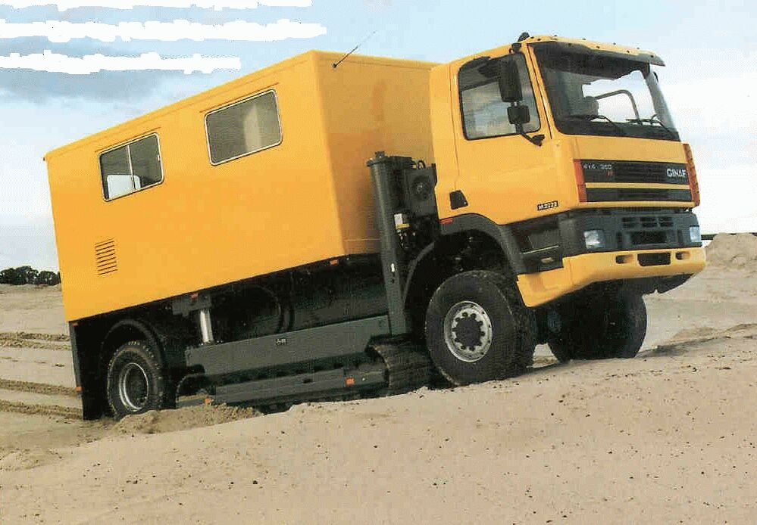
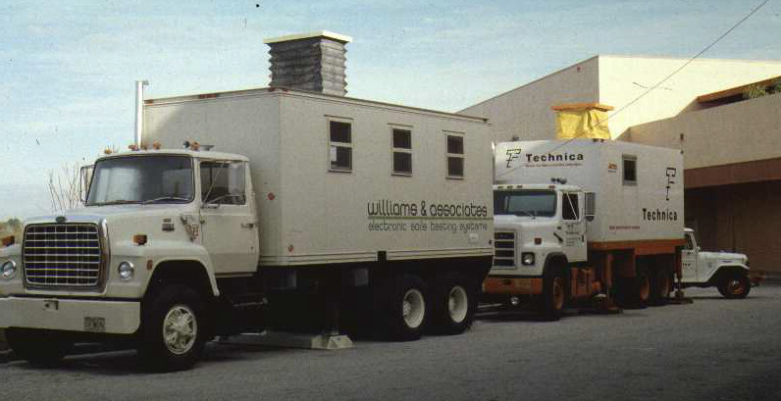

Cone Penetration Vehicles

Slide 26

Georgia Tech Anchored Cone Rig
6-tonne CPT truck with 20-tonne hydraulic pushing system
No special license
Twin earth anchors
Has been used at sites in GA, VA, NC, SC, IL, FL, AR, MO, TN, KY, and AL
Downtown Atlanta, Georgia

Slide 27

Geotechnical Site Characterization
Soils Laboratory vs In-Situ Testing
Lab Rat Field Mouse

Slide 28










Cone Penetrometer Rigs

Slide 29





AutoCoson - Robotic CPT
by A.P. van den Berg, Holland
PROD = Portable Remotely Operated Drill
by Benthic Geotech Australia

Slide 30





Special CPTs
Resistivity Cones
Seismic CPT
Conductivity CPT
Gamma CPT
pH CPTu
Vision CPT (VisCPT)
Dielectric CPTu
Acoustic CPT
Radio-isotope CPT
Vibrocone (VCPT)

Slide 31






Specialty Cone Penetrometers
VisCPT = vision penetrometer (Hryciw 2004)
Clean
Sand
Silty
Sand
Silty
fine
Sand
Silty
Clay
Sapphire
window
Visual data
acquisition
recording
system

Slide 32





Cone Penetrometer Testing
圆锥贯入试验
Chinese CPT Equipment
www.madeinchina.com

Slide 33




Cone Penetrometer Testing
Hand-held electronic cone penetrometers
Measured Penetration Resistance
Spectrum
Scout SC 900
Rimik CP40
Eijkelcamp
Excellent Repeatability

Slide 34




CPT'10 - Summary Regional Reports
CPTs Halley Research Station - Antarctica

Slide 35


CPT'10 - Summary Regional Reports
CPTs to Measure Strength of Polar Ice - Antarctica
Cone Resistance, q_{c} (MPa)
0 2 4 6 8 10 12 14
0
1
2
3
4
Depth (meters)
Adrian McCallum
Scott Polar Research Institute (SPRI)
Lankelma, UK

Slide 36

Earth
CPTs
all 7 continents
all 5 oceans

Slide 37

Mars

Slide 38





Launched May 2018
Landed November 2018

Slide 39








External Geotechnical Review Team (23 Jan 2013)
Martian
Penetrometer

Slide 40




Interpretation Methods for In-Situ Tests
Empirical
Analytical
Statistical
Dislocation Theory

Slide 41




Interpretation Methods for In-Situ Tests
Finite Elements
Strain Path Method
Finite Differences
Discrete Elements

Slide 42
CPT Computer Programs for Interpretation
GEO5 Pile CPT (gintsoftware)
GLAMCPT (Omer 2006)
CPeT-IT (geologismiki.gr)
LPD-CPT (Louisana State University)
Conrad (Swedish Geotech Institute)
CPTINT (Dick Campanella)
CPTLiq (Geosoftwaresolutions)
CPT-Log (Geotech.se)
DCCONE (dc-software.com)
Edison - SGI
MFoundation (GeoDelft)
CPT-Pro (www.geosoft.com.pl)
P-Class - (LSU and LTRC, Louisiana)
PL-aid (McTrans at Univ. Florida)
RapidCPT (dataforensics.net)
Shake2000 (CPT for soil liquefaction)
Static Probing (www.geostru.com)
Unipile (www.unisoftltd.com)
Georit (Geotech AB)
CPT7 (GeoMil Equipment)
ScreenZw (ConeTec)
CPTGL (Geotech AB reduction)
Go! (van den Berg)
Almeid (UWA)
CPTPlot
CLiq (geologismiki.gr)
GeoExplorer (Gouda-Geo Equip)
SPAS 2009 (geologismiki.gr)
INSITU (www.geo&soft.com)
OpenSounding (sourceforge.net)
PCL-pro (Geotech)
PlotCPT (GeoMil Equipment)
SCPT-DAA (Baziw)
Static Penetrometer (Alpes-Geo)
LCPC360A (ConeTec)
FB-Deep (Univ. of Florida)
Gorilla (A.P. van den Berg)
NovoCPT 1.2 (novosoftware.com)

Slide 43
Recent advancements in interpretation
Geostratigraphy and soil type
Initial state and geostatic stresses
Relative density, D_{R}
Unit weight, γ_{t}
Yield stress, σ_{p}' and YSR = yield stress ratio
Effective stress friction angle, φ'
Rigidity index, I_{R} = G/s_{u}
Undrained shear strength, s_{u}
Small-strain stiffness, G_{max}
Stress-strain-strength response: τ−γ−τ_{max}
Permeability (k) and coefficient of consolidation, c_{v}
Direct methods for shallow footing foundations
Direct CPT methods for deep foundations
State parameter, ψ
Flow and cyclic liquefaction evaluation

Slide 44
CPT Charts for Soil Behavioral Type
Soil Behavioral Type (SBT) charts (Robertson, CGJ, 1990, 1991)
Uses all 3 readings (q_{t}, f_{s}, u₂)
Define normalized piezocone parameters:
1. Normalized Tip Resistance: Q = (q_{t} - σ_{vo})/σ_{vo}'
2. Normalized Sleeve Friction (%): F = 100 ⋅ f_{s}/(q_{t} - σ_{vo})
3. Normalized Porewater Pressure: B_{q} = (u₂-u₀)/(q_{t} - σ_{vo})
4. Updated Q_{tn} = (q_{t} - σ_{vo})/(σ_{vo}')^{n} where units of atm (≈ tsf)
with n = 1 clay and n = 0.5 in sand (Robertson 2009, 2016)

Slide 45

Stiff
clayey
Sand
(Zone 8)
Robertson
(1990, 1991)
Canadian
Geotechnical
Journal
Gravelly SANDS
(Zone 7)
Very
Stiff
clays
and
silts
(Zone 9)
SANDS
(Zone 6)
Sandy Mix
(Zone 5)
Silty Mix
(Zone 4)
CLAYS
(Zone 3)
Sensitive Soils
(Zone 1)
Organic
(Zone 2)

Slide 46
Soil Behavioral Type Using CPT Index, I_{c}
Use of CPT Material Index (I_{c}) for identification of soil type (Robertson & Wride, 1998):
Modified normalized tip resistance (Robertson 2004):
Exponent n = 0.5 (sands), 0.75 (silts), n = 1.0 (clays)
Iterate to find exponent n (Robertson 2009 CGJ):
sands: I_{c} < 2.05
clays: I_{c} > 2.95

Slide 47
Soil Behavioral
Type (SBTn) Chart
for normalized CPT
(after Robertson 2009)
I_{c} < 2.6: Drained
I_{c} > 2.6: Undrained
Approximate
Algorithm Steps:
a. Find sensitive soils of zone 1 identified when: Q_{tn} < 12 exp(-1.4 F_{r} )
b. Identify: Zone 8 (1.5 < F_{r}< 4.5%) and Zone 9 (F_{r} > 4.5%):
c. Use CPT index I_{c} for Zones 2 through 7

Slide 48
Undisturbed Sand Database
24 Sands to Silty Sands (n = 54 Triaxial Tests)

Slide 49
Direct CPT method for φ' in sands
Exponent
n ≈ ½

Slide 50
Direct CPT method for φ' in sands
45°
Range
of φ'
32°

Slide 51
Triaxial Compression Tests on Korean Soft Clay
Drained and Undrained Series
(Lee et al. 2000)
Notes:
bigg

Slide 52

Principle of effective stress: σ' = σ - u
Triaxial Compression Piezocone Penetrometer
Deviator Stress
q = σ_{v} - σ_{h}
cone
resistance
porewater
pressure
u₂
q_{t}
Triaxial
Cell
Cell Pressure
σ_{h}
σ_{h}
Valve
Soil Column
z > 30m
Billions of soil particles tested
pore pressure, u
Test one specimen
Notes:
L: TX cell one point R: CPTu test infinite number of soil particles Put q on the TX part for CPTu, put qt, u2 bigger and full name

Slide 53
Effective Stress Friction Angle φ' from CPTu
q_{net} = (N_{q} - 1)∙(σ_{vo}' + a') - N_{u} ∙Δu₂ = q_{t} - σ_{vo}
N_{q} = tan²(45°+φ'/2)∙exp[(π−2β)∙tanφ']
N_{u} = 6∙tanφ'∙(1+tanφ')
φ' in all soil types
Norwegian Institute of
Technology (NTH); NTNU
Janbu & Senneset (1974)
Senneset et al. (1982)
Senneset & Janbu (1985)
Sandven et al. (1988)
Senneset et al. (1988)
Senneset & Janbu (1989)
Sandven (1990)
Sandven & Watn (1995)
Sandven et al. (2016)
Ouyang & Mayne (2018)
a' = c'∙cotφ' = attraction
β = angle of plastification

Slide 54
Effective Stress Piezocone Penetration
NTH: Sandven (1995), Senneset, Sandven, and Janbu (1989)

Slide 55

Soft Clay at Northwestern University
u₂
q_{t}

Slide 56
N_{m} = Q = 3.05

Slide 57
B_{q} = 0.79

Slide 58
Soft Clay at Northwestern University
β = 0
B_{q} = 0.79
Q = 3.05
φ’ = 28.8°

Slide 59
Soft Clay at Northwestern University
CAUC Triaxial Test Series

Slide 60
Approximate NTH Solution for φ' from CPTu
Theory:
Approx: φ' ≈ 29.5°∙B_{q}^{0.121}∙[0.256 + 0.336∙B_{q} + log Q ]
c' = 0
β = 0°
Theory (dots)
Approximation (lines)

Slide 61
Boston Blue Clay at Newbury, Massachusetts
(Landon, 2007, Univ. Mass - Amherst)
Approx
NTH Method
for CPTu
Mean CK₀UC
of Block
and Piston
Samples

Slide 62


Miniature CPTu in Clay Centrifuge Deposits
(Ouyang and Mayne, CPT'18, Delft)
10mm Mini-Piezocone at UWA
Zhejiang University Centrifuge

Slide 63
Database of Laboratory CAUC/CIUC Triaxial φ’ Tests and Field CPTu in Clays
N = 105 Clays
(Ouyang & Mayne, CGJ 2018)

Slide 64


Comparison of Triaxial φ’ and NTH φ’ from CPTu
Triaxial
Apparatus
Electronic
Piezocone
Penetrometers

Slide 65


by Jeff Keane

Slide 66
Benchmark: Yield Stress from Consolidation Tests
σ_{vo}' = 43 kPa
σ_{p}' = 80 kPa
(most probable)
Casagrande Method (1936)

Slide 67
Cavity Expansion-Critical State Model for CPTu-OCR
Clay Properties:
M = 6 sinφ’/(3-sinφ’)
φ’ = effective friction angle
C_{c} = compression index
C_{s} = swelling index
Λ = 1 – C_{s}/C_{c}
I_{R} = G/s_{u} = Rigidity Index
G = shear modulus
s_{u} = undrained shear strength
φ’, C_{c}, C_{s}
Mayne (1991)
Chen & Mayne (1994)
Burns & Mayne (1998, 2002)
Mayne (2005, 2007)
Mayne (2017)

Slide 68
SCE-CSSM Analytical Solution
Clays
u₂
q_{t}
Notes:
M = 6 sinφ'/(3-sinφ')
I_{R} = G/s_{u}
Λ = 1 – C_{s}/C_{c} ≈ 0.80
(clays and sands)
Rigidity Index

Slide 69

THIS U2
f_{s}
u₂
q_{t}

Slide 70
SCE-CSSM Theory
For Λ = 1
φ’ = 30º and I_{R} = 100
First-Order Approximations
for inorganic insensitive clays

Slide 71
San Francisco Bay Mud
Islais Creek (Hunt, Pestana, Bray - JGGE 2002)
Miscellaneous Fill
q_{net}
Δu₂
Young
Bay Mud
q_{E}
Clayey
Sand
Clayey
Sand
Young
Bay Mud
Young
Bay Mud

Slide 72

Edinburgh
Bothkennar Test Site - Scotland
(Hight et al, 2003; Powell and Lunne, 2005)

Slide 73




Evaluating Yield Stresses in Sands by CPT
Oxford
University
Calibration Chambers
Flexible Wall Chambers
Essentially large triaxial test
Virginia Tech

Slide 74
CPT Chamber Test Series on 26 Sands
Earlston
Edgar
Erksak
Frankston
Hilton Mines
Hokksund
Hostun
Lanchester
Leighton Buzzard
Light Castle Sand
Each Chamber ≈ 8 to 10 tons of sand
Takes one week to prepare by 3 personnel
Each CPT takes 20 seconds
Oosterschelde
Lone Star
Monterey
Ottawa
Reid-Bedford
South Oakleigh
Ticino
Toyoura
Washed Mortar Sand

Slide 75

CPT Methodology in Clean Quartz Sands
Apparent Overconsolidation Ratio, OCR (or Yield Stress Ratio, YSR):
φ’ = effective stress friction angle
q_{t} = cone tip resistance
σ_{vo}’ = effective vertical stress
σ_{atm} = atmospheric pressure (1 bar = 100 kPa)

Slide 76
CPT Calibration Chamber Test Data on Sands
Apparent Overconsolidation Ratio, OCR, or Yield Stress Ratio, YSR:
SANDS (706 chamber tests)
where σ_{atm} = atmospheric pressure (1 atm ≈ 1 bar = 100 kPa).
For φ’ = 35°
First-Order
Approximation
206 CLAY SITES
Units
of kPa

Slide 77
Effective Yield Stress of Soils from CPT
CLAYS
SILTS / MIXED
SANDS
σ_{p}' =0.33(q_{tnet})^{m}

Slide 78



Blessington Sand Site
University of College Dublin (UCD)
Doherty et al. (2012)
Tolooiyan & Gavin (2011)

Slide 79
Dense OC Sand Site, Blessington, Ireland
(Dougherty et al. 2012; Gavin et al. 2014)
Consolidation
Tests
Dense
Fine
Sand

Slide 80

Unified Approach: Yield Stress versus Net Cone Resistance
Robertson & Cabal (2015)

Slide 81

Unified Approach: Evaluating Yield Stress of Various Different Geomaterials Using CPT

Slide 82
Yield Stress Exponent m’ Trend with CPT Material Index, I_{c}
Zone No. = 7 6 5 4 3 2
SANDS
Fissured
Clays
Intact Clays
SILTS
Silts
Quartz and
Silica Sands
For I_{c} < 3.5
CLAYS

Slide 83


OC Sand at Cuxhaven, Germany (Quinteros et al. 2018)
North Sea
Cuxhaven

Slide 84


OC Sand at Cuxhaven, Germany
(Quinteros, Lunne, Krogh, et al. CPT'18)
Calculated OCR due to 18 m of excavated overburden removal
Sand
Clay

Slide 85
Shear Wave Velocity, V_{s}
Fundamental measurement in all solids (steel, concrete, wood, soils, rocks)
Initial stiffness represented by the small-strain shear modulus (G_{dyn} = G_{max} = G₀):
G₀ = ρ_{t} V_{s}² where total mass density ρ_{t} = γ_{t}/g_{a}
Applies to all static & dynamic problems at small strains (γ_{s} < 10⁻⁶)
Applicable to both undrained & drained loading cases in geotechnical engineering

Slide 86
Comparison MASW and DHT - Richmond, BC
200 m/s
Bad
Good

Slide 87

Field Geophysics - Mechanical Wave Methods
Seismograph
+ Source
DHT
Oscilloscope
+ Source
Spectral
Analyzer
+ Source
SFLS
SFRS
Geophones
Cased
Boreholes
V_{s}RW
Receivers
V_{p}
high frequencies
V_{s}HH
UHT
medium frequency
content
V_{s}VH
SRFS = Surface Refraction Survey
SFLS = Surface Reflection Survey
SASW = Spectral Analysis of Surface Waves
MASW = Modal Analysis (Rayleigh Waves)
CSW = Continuous Surface Waves
PSW = Passive Surface Wave Testing
ReMi = Reflection MicroSeis
SLP = Suspension Logger Problng
CHT = Crosshole Test
RCHT = Rotary Crosshole
DHT = Downhole Test
UHT = Uphole Test
SCPTu = Seismic Piezocone Test
SDMT = Seismic Flat Dilatometer Test
BTSD = Borehole Torsional Shear Device
Vertical
Source
V_{s}HV
CHT
low
frequency
content
V_{s}HH
RCHT
Rotary
Source
Rayleigh Wave Methods
Torsional
Source
BTSD
SLP
SASW
MASW
CSW
PSW
ReMi
V_{s}HH
V_{s}VV

Slide 88

Seismic Piezocone Penetration Testing (SCPTu)
D 7400

Slide 89
SCPTu at Meramac River, Missouri
Cone Resistance Sleeve Friction Pore Pressure Shear Wave Velocity
V_{s}
f_{s}
u₂
q_{t}

Slide 90
Costs of Methods to profile V_{s} to 30 m
METHOD | TYPICAL COST
Suspension Logging (PSSL) | $ 9,000
Crosshole Testing (CHT) | $ 22,000
Downhole Testing (DHT) | $ 9,000
Surface Waves (SASW, MASW) | $ 4,500
ReMi Passive Surface Waves | $ 2,500
Seismic Piezocone* | $ 2,000
NOTE:
* Includes 4 separate readings with depth: q_{t}, f_{s}, u₂, and V_{s}

Slide 91


Seismic Piezocone (SCPTU) - Ithaca, NY
Cone Resistance
q_{t} (tsf)
Sleeve Friction
f_{s} (tsf)
Pore Pressure
u₂ (feet)
Shear Wave
V_{s} (fps)
Soil Behavior
Type (SBT)
Depth (feet)

Slide 92

Geotechnical Methods for Site Investigation
Soils Laboratory In-Situ Testing
Geophysics
Lab Rat Field Mouse
Fruit Bat
Field mouse with
ball penetrometer

Slide 93

SCPTu from Perth, Australia
(Schneider, et al. 2004; Low et al. 2011)
Burswood
Soft
Clay

Slide 94
Soil Parameter Evaluation at Burswood by SCPTu
(Data from Univ. Western Australia: Schneider 2004; Low 2009)

Slide 95
DSS curves for Burswood by SCPTu
(Data from Low, 2004: Univ. Western Australia)
τ = G ∙ γ_{s}
G/G_{max} = 1 - (τ/τ_{max})^{0.25}
τ_{max} = s_{u} = ½sinφ'OCR^{Λ}σ_{vo}'
OCR = 0.33(q_{t}-σ_{vo})/σ_{vo}'
G_{max} = ρ_{t} V_{s}²

Slide 96
CREC Site, Charleston, SC (Esposito, Andrus & Camp 2014)
Frozen Sand Samples Taken
Clean
Sand (SP
and SP-SM)
Sand with
clay & shells
(SP-SC)
silty
Sand
(SM)
(marl)

Slide 97

CREC Site, Charleston, SC
Sand sampled using freezing
(Esposito & Andrus 2016 JGGE)
SCPTu
SCPTu

Slide 98
SCPTu in Memphis, Tennessee

Slide 99


Input Parameters for Plaxis FEM
(Schweiger 2012): Hardening Soil Small Model
Input from SCPTu
√ SBT or f_{s}
√ V_{s} or f_{s}
√ q_{t1}
√ NTH N_{m}
√ q_{t1}
ν' = 0.2; ν_{u} = 0.5
√ V_{s} and Q_{tn}
√ I_{c} and Q_{tn}
√ V_{s} and Q_{tn}
√ I_{c}
σ_{atm} = 100 kPa
√ q_{t}, OCR, φ'
-
-
√ V_{s}
-

Slide 100
Porewater Pressure Dissipation Tests
MONOTONIC
DILATORY

Slide 101

SCPTù at Atlanta Airport Runway 5
Five Independent Readings of
Soil Behavior: q_{t}, f_{s}, u₂, t₅₀, V_{s}

Slide 102
Centrifuge CPTu Twitch Testing in Kaolin (Schneider 2007)
Standard rate of 20mm/s
Notes:
Check V

Slide 103
Centrifuge CPTu Twitch Testing in Kaolin (Schneider 2007)
Standard rate of 20mm/s
Notes:
Check V

Slide 104
Variable Rate CPTu in Clay Centrifuge Deposit
(Variable rate CPTu data from Mahmoodzadeh and Randolph 2014: University of Western Australia)
Notes:
M&R

Slide 105
Variable Rate CPTu in Clay Centrifuge Deposit
(data from Mahmoodzadeh & Randolph 2014)
Lab Triaxial Tests
on Speswhite
Kaolin: φ' = 21.6°
Notes:
M&R

Slide 106


Axial Pile Capacity: Q_{total} = Q_{sides} + Q_{base}
Q_{t}
Atlanta Hartsfield
Ground Surface
unit side
friction, f_{p}
Shaft Capacity
Q_{s} = ∫ f_{p} dA_{s}
Vietnam Port Facility
Base Capacity
Q_{b} = q_{b} ∙ A_{b}
unit base resistance, q_{b}

Slide 107
Direct CPT Methods for Axial Pile Capacity
Almeida et al. (1996, BRE-NGI)
Eslami and Fellenius (1997)
Jardine & Chow (1996, MTD)
Takesue et al. (1998, KTRI)
Lee & Salgado (1999, ASCE JGGE)
Powell, et al. (2001, 15th ICSMGE)
Jamiolkowski (2003 BAP - Ghent)
Fugro-05 Kolk et al. 2005
ICP-05 Jardine et al. 2005
Abu-Farsakh & Titi (2004, JGGE)
UWA-05 Lehane et al. 2005
Xu et al. (2006, JGGE)
Van Dijk and Kolk (2011, ISFOG-II)
Aoki & de Alencar (1975 Pan-Am)
Schmertmann (1978, FHWA Rept)
de Ruiter & Beringer (1979)
Bustamante & Gianeselli (1982)
Zhou et al. (1982, ESOPT)
Tumay & Fakhroo (1982)
Price & Wardle (1982, ESOPT)
Van Impe (1986, 4th IGS)
Robertson et al. (1988, ISOPT-1)
Alsamman (1995, PhD, UIUC)
NGI-05 Clausen et al. 2005
Fioravante et al. (1995, 10th ARC)
Schneider et al. (JGGE 2008)
Lehane et al. (UWA 2012)
Niazi & Mayne (2015, 2017)

Slide 108

Enhanced Unicone Method (Niazi & Mayne 2016)
North America (40 Sites)
Canada: 11 Sites
USA: 28 Sites
Puerto Rico: 1 Site
Europe (21 Sites)
Belgium: 2
France: 4
Ireland: 3
Netherlands: 2
Norway: 2
Portugal: 1
United Kingdom: 7
Unicone Method (1997): 102 load tests
Enhanced Unicone (2016): 330 load tests
www.mapcruzin.com
Overview
330 pile load tests
70 sites
19 countries
CPT Soundings
SCPT/SCPTu: 59
CPTu: 9
CPT: 4
Asia (7 Sites)
China: 2
Iraq: 1
Japan: 2
Malaysia: 1
Thailand: 1

Slide 109
Enhanced Unicone: Pile Side Friction: f_{p} = C_{se}·q_{E}
C_{se} = C_{se(mean)} ∙ θ_{PileType} ∙ θ_{t-c} ∙ θ_{rate}
SIDE FRICTION
Pile Type:
Bored Piles: θ_{PileType} = 0.84
Jacked Piles: θ_{PileType} = 1.02
Driven Piles: θ_{PileType} = 1.13
Direction of Loading:
Rate of Loading:
Compression: θ_{t-c} = 1.11
Tension/Uplift: θ_{t-c} = 0.85
CRP: θ_{rate} = 1.09
MLT: θ_{rate} = 0.97
CRP = constant rate
of penetration
MLT = maintained load test
Pile End Bearing Resistance: q_{b} = C_{te}·q_{E}

Slide 110
RIGID PILE RESPONSE
Direct CPT Approach
Q_{tu} = Q_{s} + Q_{b}
Q_{su} = Σ (f_{p} dA_{s})
CPT
PILE
Q_{bu} = q_{b} A_{b}
V
Top Displacement, w_{t}
E_{max} = 2 ρ_{t} V_{s}² (1+ν)
unit side friction, f_{p}
V_{s}
f_{p} = fctn (I_{c} and q_{E})
f_{s}
u₂
Load Transfer
q_{t}
q_{E} = q_{t} - u₂
I_{c} = fctn (Q and F)
q_{b} = unit end bearing
q_{b} = fctn (I_{c} and q_{E})

Slide 111

I-85 Bridge, Coweta County, Georgia
Drilled Shaft Load Test: d = 0.914 m; L = 20.1 m

Slide 112

SCPTu at I-85 Bridge
Coweta Georgia

Slide 113
Axial Load Response of Coweta Shaft
Q_{t}
Q_{s}
Q_{b}

Slide 114


GT Roto AutoSeis
Electro-Mechanical off 12-volt
AC or DC power; variable speed
Repeatable, Portable, reach 30-m depths
Can generate shear wavelets every 1 second
Patent received in February 2010

Slide 115

Continuous Shear Waves, Brisbane, Australia

Slide 116

Wavelet signals from continuous V_{s} at Norfolk
20 meter depth

Slide 117



Continuous SCPTu at Norfolk, VA

Slide 118


Very deep SCPTu - Vancouver, BC
460 feet =

Slide 119

Thanks to the Cornell Professors
Fred H. Kulhawy
Dwight Sangrey
J. Neil Kay
Harry Stewart
Tom O'Rourke
Ken Hover
Lynne Irwin
John Abel
Peter Gergely
Dan Karig
Tony Ingraffea
Daniel P. Loucks
Yervant Terzian
Carl Sagan
Prof. Sherif
Wissa Agaiby
(1962-2019)
Prof. Fred
H. Kulhawy
(1943-2015)
Prof. Paul
W. Mayne -
Georgia Tech
Prof. Kok Kwang Phoon -
National
Univ. Singapore

Slide 120





Slide 121

SCPTu Sounding in Albany, NY
Cone Resistance Sleeve Friction Porewater Pressure Shear Wave Velocity
q_{t} (tsf) f_{s} (tsf) u₂ (feet) V_{s} (feet/sec)
Depth (feet)

Slide 122
CPTu Databases from Chamber, Centrifuge and Field Tests
B_{q}=
Notes:
Add Bq

Slide 123

SCPTu from Steele, Missouri

